Slide 1
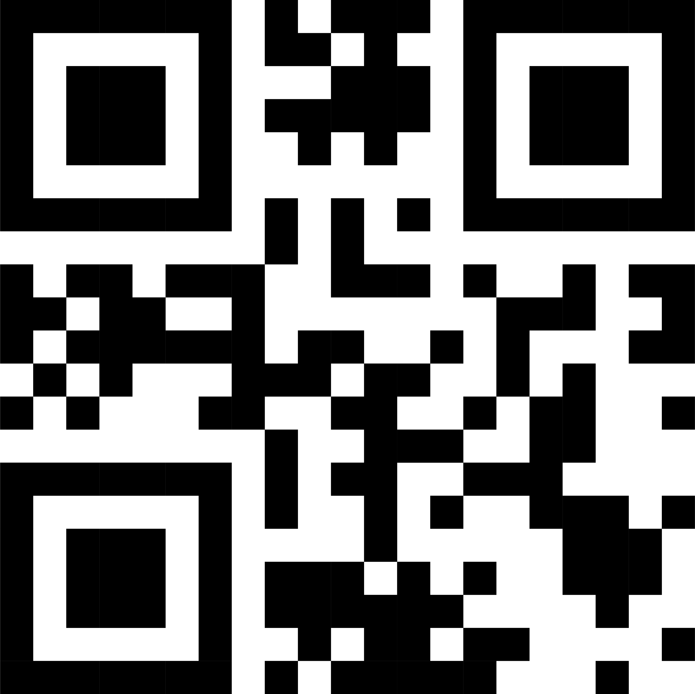
CUSTOM MICROSITES
At ICI Creative Solutions, we understand that each organization has unique needs. Our Custom Websites are designed to provide a personalized approach to employee benefits information, ensuring content that aligns perfectly with your specific requirements.
MICROSITES WE CREATE
Structured for Clarity and Ease
Our process starts with a detailed site map to outline your microsite’s structure, guaranteeing an organized and user-centric layout. This meticulous planning ensures that every piece of information is where you and your employees need it to be.
Brand-Aligned Content Creation
We don’t just build websites; we craft experiences that resonate with your brand’s voice. Our team specializes in writing and editing content to match your organization’s tone and style, making the information not just informative but also relatable.
Secure and User-Friendly Design
Once the design is approved, we construct a fully customized microsite. Our focus is on security and ease of use, ensuring a safe and smooth experience for all users.
MICROSITES MAKE IT BETTER
ICI’s Custom Websites serve as a dynamic educational tool, aiding both current and future understanding of employee benefits. It’s more than a website; it’s a cornerstone for benefits engagement in your organization.
CONTACT US TODAY TO GET STARTED.
View a Custom Site Live
ENGAGE
INSPIRE
MOTIVATE
EDUCATE

